Slide 1

Section 1: Networking Today

Slide 2
1.1 Networks Affect Our Lives

Slide 3


Networking Today Networks in Our Daily Lives
Welcome to a world where we are more powerful together, than we ever could be apart.
Welcome to the human network.

Slide 4
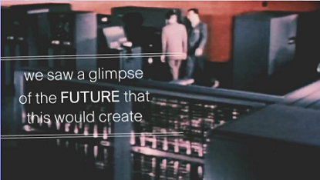
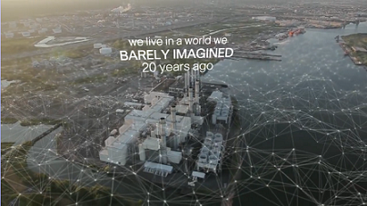
Networking Today Technology Then and Now
We live in a world we barely imagined 20 years ago.
What wouldn’t we have without the Internet?
What will be possible in the future using the network as the platform?

Slide 5

Networking Today No Boundaries
Advancements in networking technologies are helping create a world without boundaries.
The immediate nature of communications over the Internet encourages global communities.
Cisco refers to the impact of the Internet and networks on people the “human network”.

Slide 6


Networking Today Networks Support the Way We Learn
Do you remember sitting in a classroom, like this?
You don't have to be in school anymore to take a class. You don't have to be in a classroom to have a teacher.

Slide 7

Networking Today Networks Support the Way We Work
The globalization of the Internet has empowered individuals to create information that can be accessed globally.
Forms of communication:
Texting
Social Media
Collaboration Tools
Blogs
Wikis
Podcasting

Slide 8
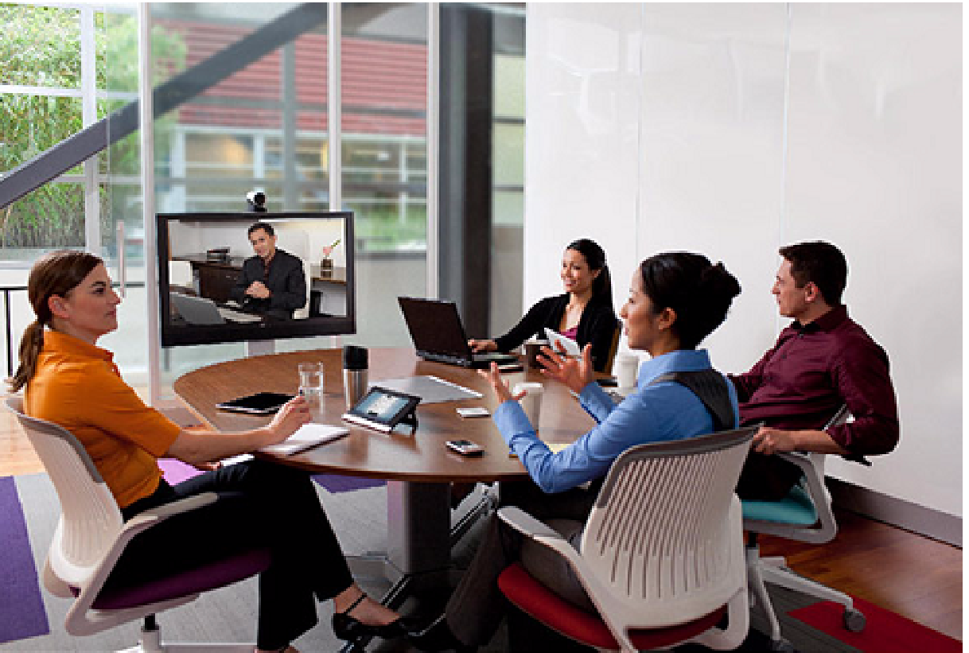
Networking Today Networks Support the Way We Work
Data networks have evolved into helping support the way we work.
Online learning opportunities decrease costly and time consuming travel.
Employee training is becoming more cost effective.

Slide 9
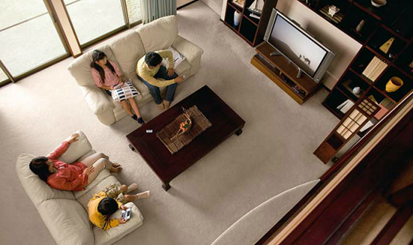
Networking Today Networks Support the Way We Play
We listen to music, watch movies, read books, and download material for future offline access.
Networks allow online gaming in ways that were not possible 20 years ago.
Offline activities have also been enhanced by networks including global communities for a wide range of hobbies and interests.
How do you play on the Internet?

Slide 10
1.2 Network Components

Slide 11
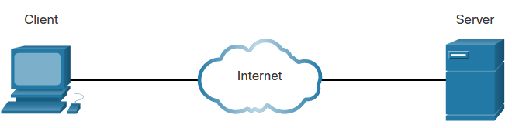
Network Components Host Roles
Every computer on a network is called a host or end device.
Servers that provide information to end devices:
email servers
web servers
file server
Clients that send requests to the servers to retrieve information:
web page from a web server
email from an email server
Server Type | Description
Email | Email server runs email server software. Clients use client software to access email.
Web | Web server runs web server software. Clients use browser software to access web pages.
File | File server stores corporate and user files. The client devices access these files.

Slide 12
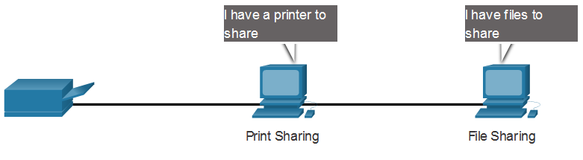
Network Components Peer-to-Peer
It is possible to have a device be a client and a server in a Peer-to-Peer Network. This type of network design is only recommended for very small networks.
Advantages | Disadvantages
Easy to set up | No centralized administration
Less complex | Not as secure
Lower cost | Not scalable
Used for simple tasks: transferring files and sharing printers | Slower performance

Slide 13
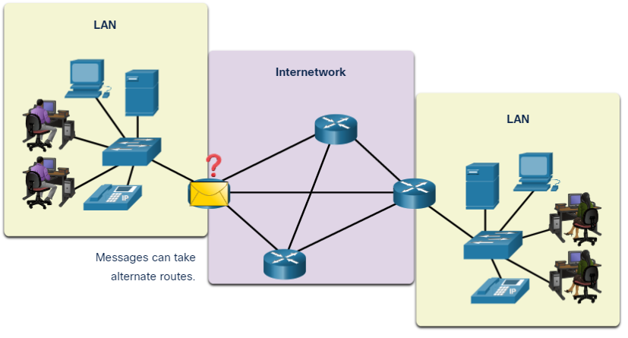
Network Components End Devices
An end device is where a message originates from or where it is received. Data originates with an end device, flows through the network, and arrives at an end device.

Slide 14
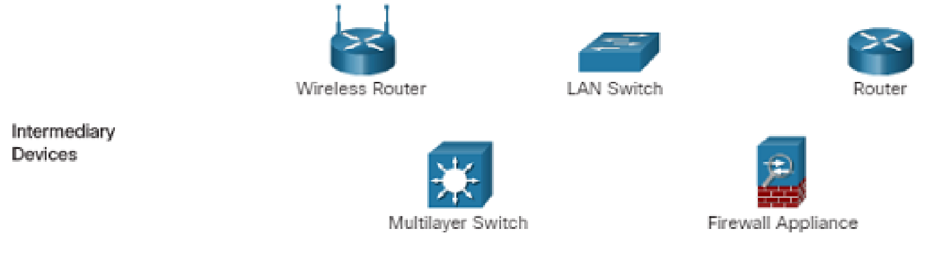
Network Components Intermediary Network Devices
An intermediary device interconnects end devices. Examples include switches, wireless access points, routers, and firewalls.
Management of data as it flows through a network is also the role of an intermediary device, including:
Regenerate and retransmit data signals.
Maintain information about what pathways exist in the network.
Notify other devices of errors and communication failures.

Slide 15
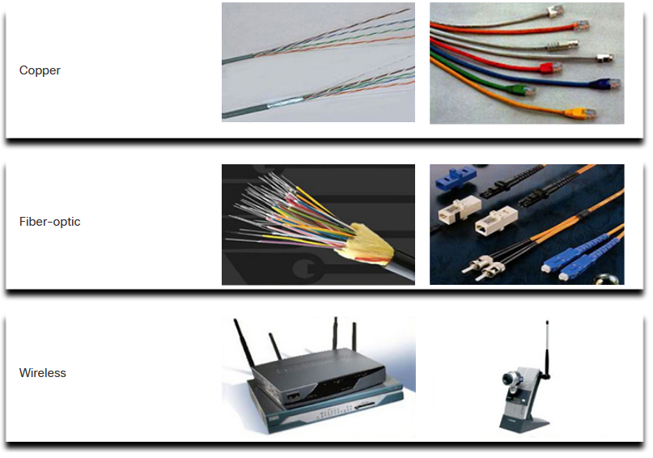
Network Components Network Media
Communication across a network is carried through a medium which allows a message to travel from source to destination.
Media Types | Description
Metal wires within cables | Uses electrical impulses
Glass or plastic fibers within cables (fiber-optic cable) | Uses pulses of light.
Wireless transmission | Uses modulation of specific frequencies of electromagnetic waves.

Slide 16
1.3 Network Representations and Topologies

Slide 17
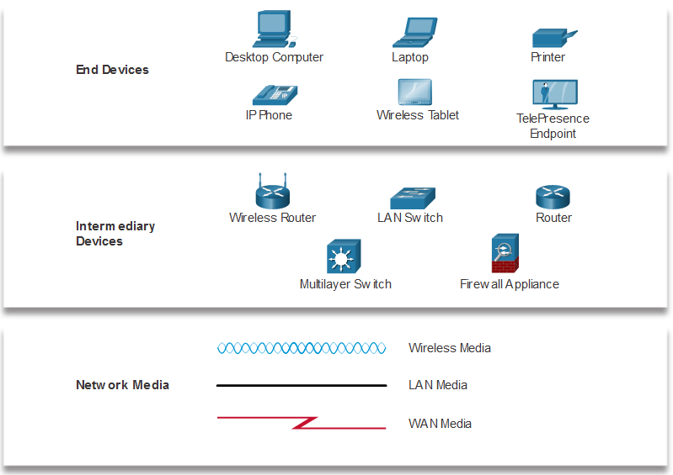
Network Representations and Topologies Network Representations
Network diagrams, often called topology diagrams, use symbols to represent devices within the network.
Important terms to know include:
Network Interface Card (NIC)
Physical Port
Interface

Slide 18
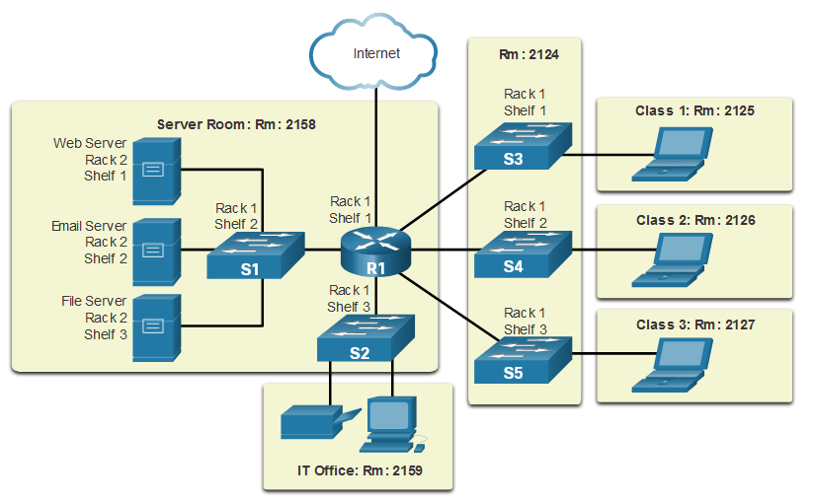
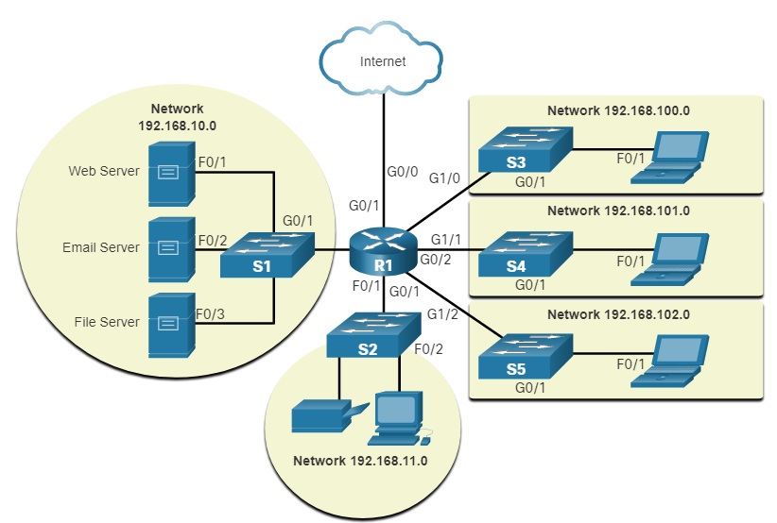
Network Representations and Topologies Topology Diagrams
Physical topology diagrams illustrate the physical location of intermediary devices and cable installation.
Logical topology diagrams illustrate devices, ports, and the addressing scheme of the network.

Slide 19
1.4 Common Types of Networks

Slide 20
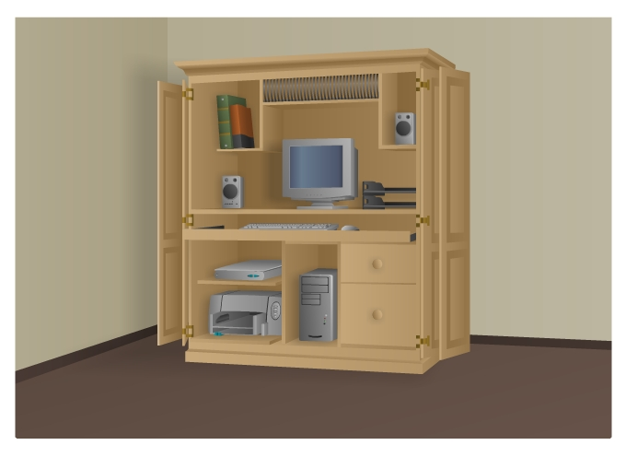
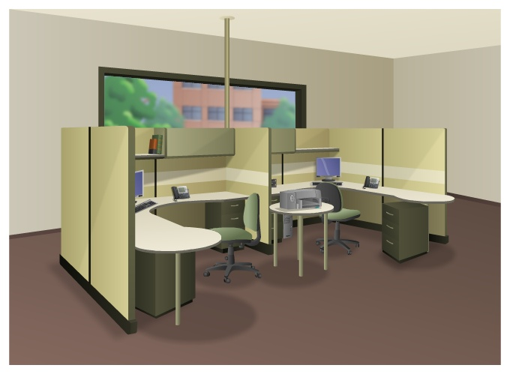
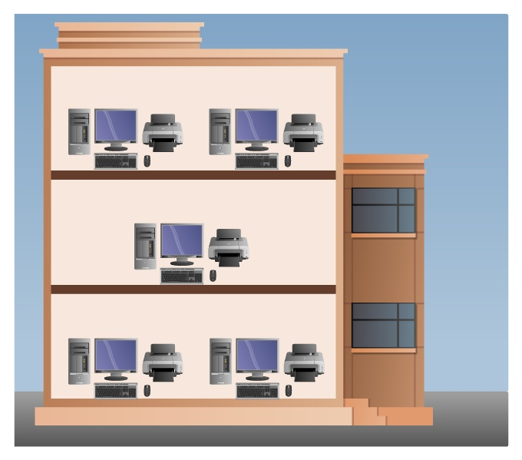
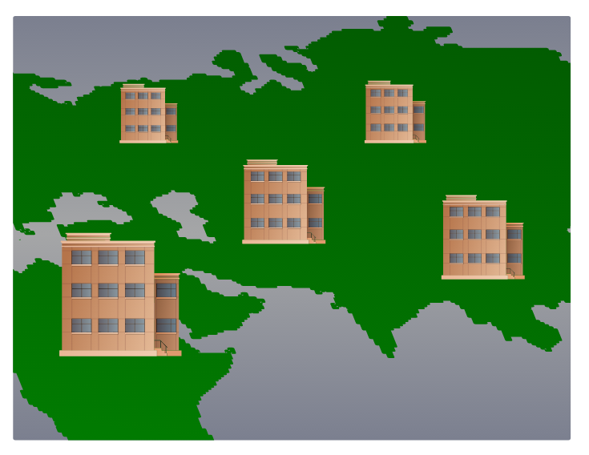
Common Types of Networks Networks of Many Sizes
Small Home Networks – connect a few computers to each other and the Internet
Small Office/Home Office – enables computer within a home or remote office to connect to a corporate network
Medium to Large Networks – many locations with hundreds or thousands of interconnected computers
World Wide Networks – connects hundreds of millions of computers world-wide – such as the internet
Small Home SOHO
Medium/Large World Wide

Slide 21
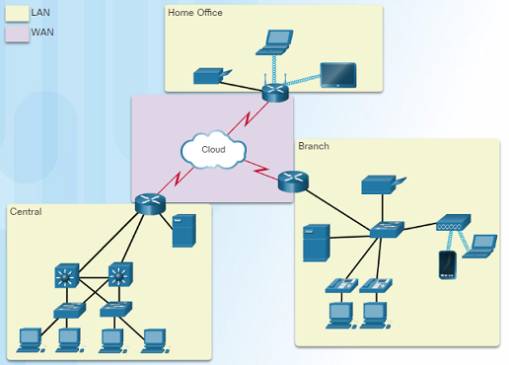
LANs and WANs Types of Networks
Two most common types of networks:
Local Area Network (LAN) – spans a small geographic area owned or operated by an individual or IT department.
Wide Area Network (WAN) – spans a large geographic area typically involving a telecommunications service provider.
Other types of networks:
Metropolitan Area Network (MAN)
Wireless LAN (WLAN)
Storage Area Network (SAN)

Slide 22
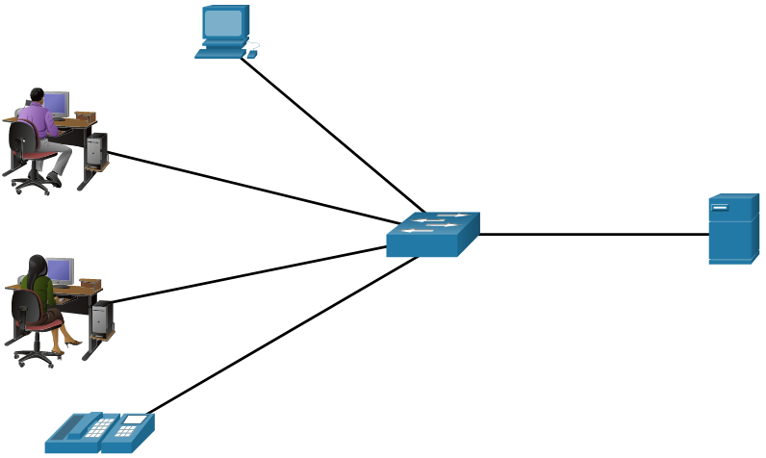
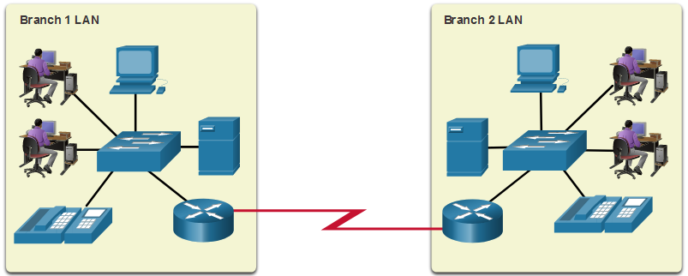
Common Types of Networks LANs and WANs (cont.)
A LAN is a network infrastructure that spans a small geographical area.
A WAN is a network infrastructure that spans a wide geographical area.
LAN | WAN
Interconnect end devices in a limited area. | Interconnect LANs over wide geographical areas.
Administered by a single organization . | Typically administered by one or more service providers.
Provide high-speed bandwidth to internal devices. | Typically provide slower speed links between LANs.

Slide 23
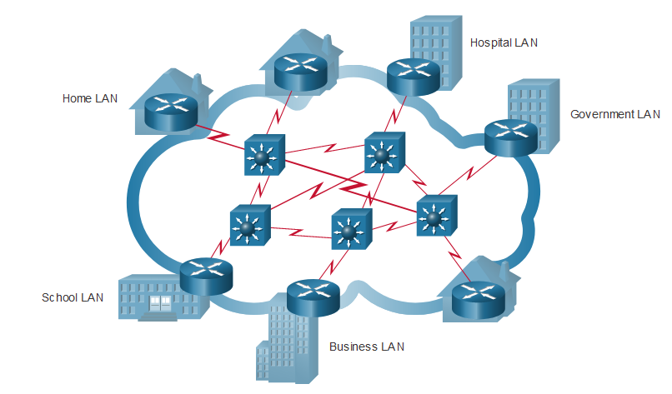
Common Types of Networks The Internet
The internet is a worldwide collection of interconnected LANs and WANs.
LANs are connected to each other using WANs.
WANs may use copper wires, fiber optic cables, and wireless transmissions.
The internet is not owned by any individual or group. The following groups were developed to help maintain structure on the internet:
IETF
ICANN
IAB

Slide 24
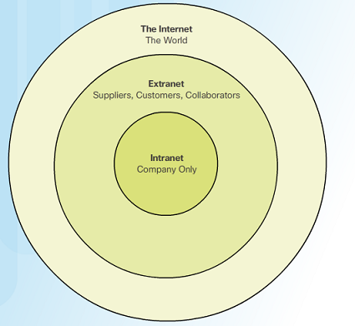
The Internet, Intranets, and Extranets Intranets and Extranets
Unlike the Internet, an intranet is a private collection of LANs and WANs internal to an organization that is meant to be accessible only to the organizations members or others with authorization.
An organization might use an extranet to provide secure access to their network for individuals who work for a different organization that need access to their data on their network.

Slide 25
1.5 Internet Connections

Slide 26

Internet Connections Internet Access Technologies
There are many ways to connect users and organizations to the Internet:
Popular services for home users and small offices include broadband cable, broadband digital subscriber line (DSL), wireless WANs, and mobile services.
Organizations need faster connections to support IP phones, video conferencing and data center storage.
Business-class interconnections are usually provided by service providers (SP) and may include: business DSL, leased lines, and Metro Ethernet.

Slide 27
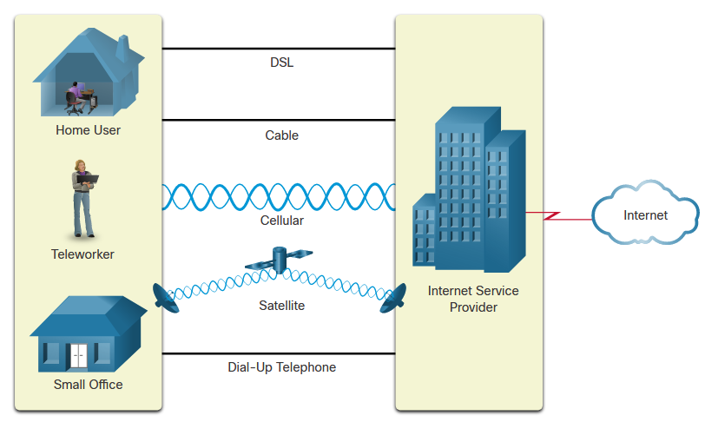
Internet Connections Home and Small Office Internet Connections
Connection | Description
Cable | high bandwidth, always on, internet offered by cable television service providers.
DSL | high bandwidth, always on, internet connection that runs over a telephone line.
Cellular | uses a cell phone network to connect to the internet.
Satellite | major benefit to rural areas without Internet Service Providers.
Dial-up telephone | an inexpensive, low bandwidth option using a modem.

Slide 28
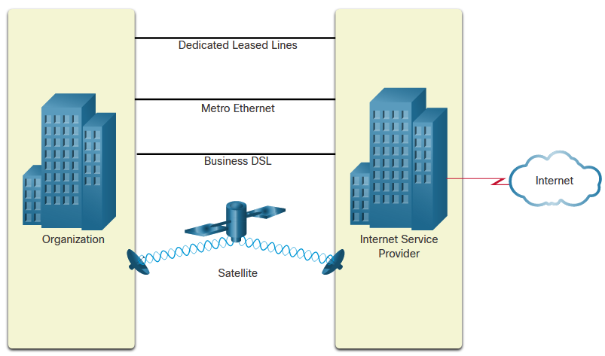
Internet Connections Businesses Internet Connections
Corporate business connections may require:
higher bandwidth
dedicated connections
managed services
Type of Connection | Description
Dedicated Leased Line | These are reserved circuits within the service provider’s network that connect distant offices with private voice and/or data networking.
Ethernet WAN | This extends LAN access technology into the WAN.
DSL | Business DSL is available in various formats including Symmetric Digital Subscriber Lines (SDSL).
Satellite | This can provide a connection when a wired solution is not available.

Slide 29
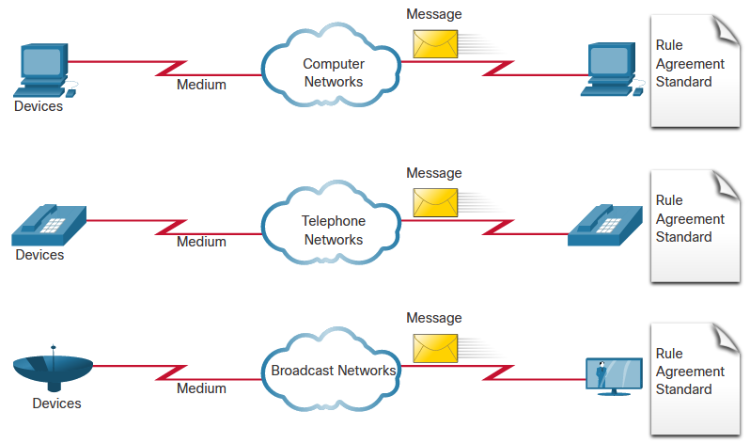
Internet Connections The Converging Network
Before converged networks, an organization would have been separately cabled for telephone, video, and data. Each of these networks would use different technologies to carry the signal.
Each of these technologies would use a different set of rules and standards.

Slide 30
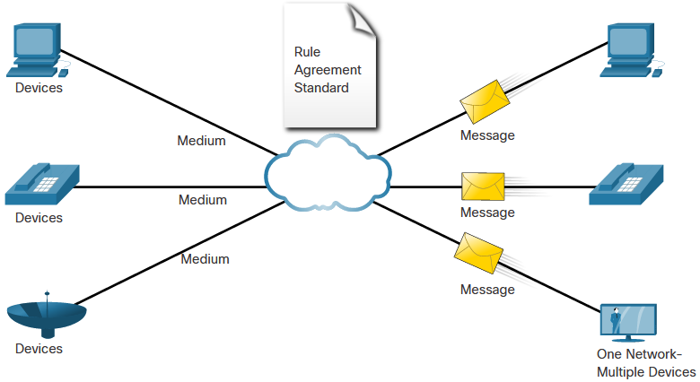
Internet Connections The Converging Network (Cont.)
Converged data networks carry multiple services on one link including:
data
voice
video
Converged networks can deliver data, voice, and video over the same network infrastructure. The network infrastructure uses the same set of rules and standards.

Slide 31
1.6 Reliable Networks

Slide 32
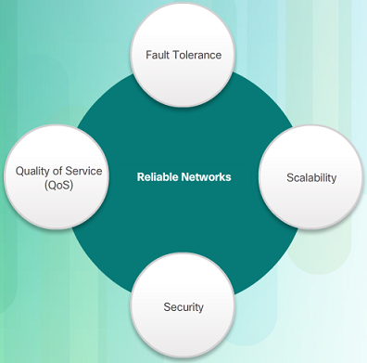
Reliable Network Network Architecture
Network Architecture refers to the technologies that support the infrastructure that moves data across the network.
There are four basic characteristics that the underlying architectures need to address to meet user expectations:
Fault Tolerance
Scalability
Quality of Service (QoS)
Security

Slide 33
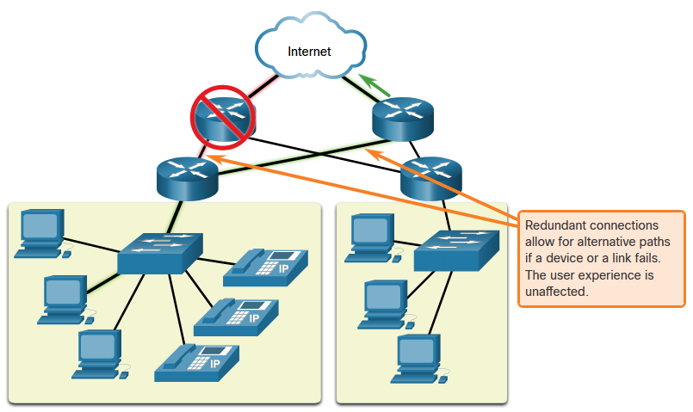
Reliable Network Fault Tolerance
A fault tolerant network limits the impact of a failure by limiting the number of affected devices. Multiple paths are required for fault tolerance.
Reliable networks provide redundancy by implementing a packet switched network:
Packet switching splits traffic into packets that are routed over a network.
Each packet could theoretically take a different path to the destination.
This is not possible with circuit-switched networks which establish dedicated circuits.

Slide 34
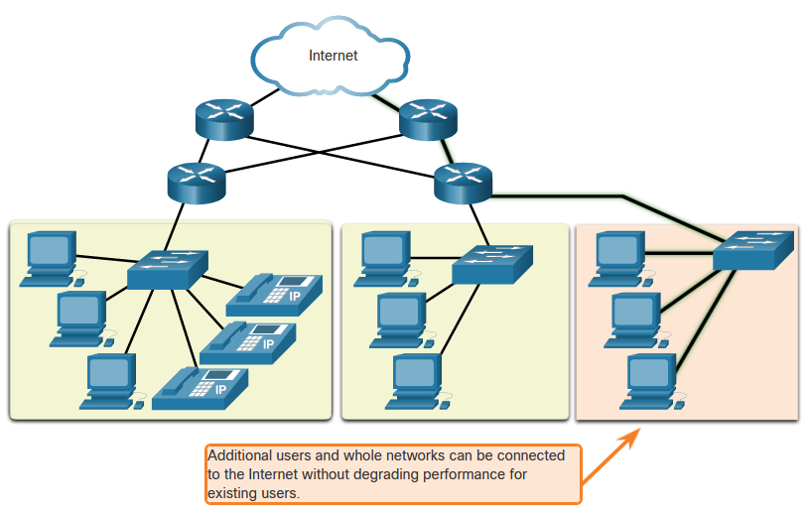
Reliable Network Scalability
A scalable network can expand quickly and easily to support new users and applications without impacting the performance of services to existing users.
Network designers follow accepted standards and protocols in order to make the networks scalable.

Slide 35
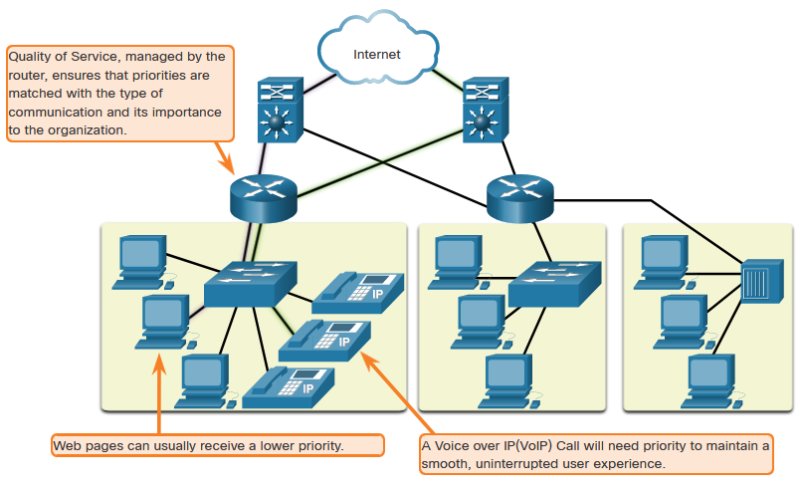
Reliable Network Quality of Service
Voice and live video transmissions require higher expectations for those services being delivered.
Have you ever watched a live video with constant breaks and pauses? This is caused when there is a higher demand for bandwidth than available – and QoS isn’t configured.
Quality of Service (QoS) is the primary mechanism used to ensure reliable delivery of content for all users.
With a QoS policy in place, the router can more easily manage the flow of data and voice traffic.

Slide 36
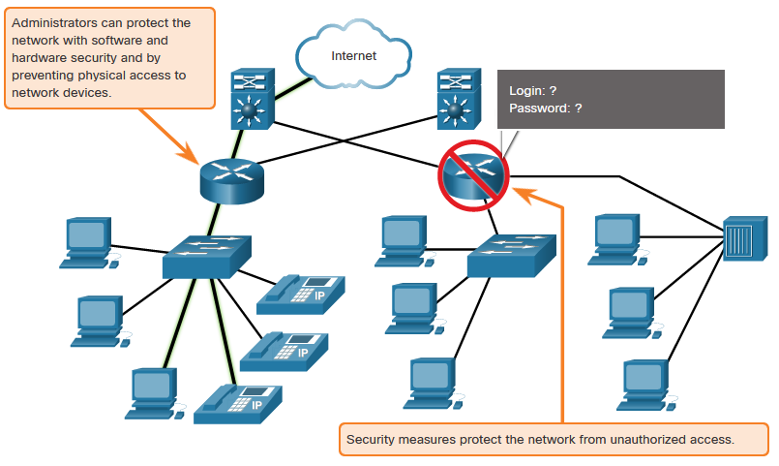
Reliable Network Network Security
There are two main types of network security that must be addressed:
Network infrastructure security
Physical security of network devices
Preventing unauthorized access to the devices
Information Security
Protection of the information or data transmitted over the network
Three goals of network security:
Confidentiality – only intended recipients can read the data
Integrity – assurance that the data has not be altered with during transmission
Availability – assurance of timely and reliable access to data for authorized users

Slide 37
1.7 Network Trends

Slide 38
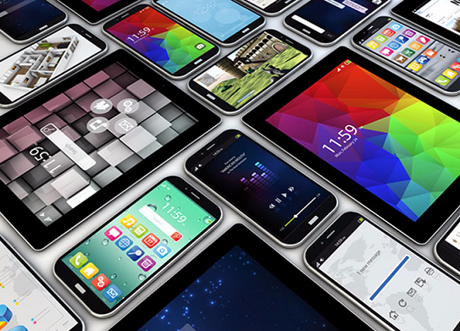
Network Trends Recent Trends
The role of the network must adjust and continually transform in order to be able to keep up with new technologies and end user devices as they constantly come to the market.
Several new networking trends that effect organizations and consumers:
Bring Your Own Device (BYOD)
Online collaboration
Video communications
Cloud computing

Slide 39

Network Trends Bring Your Own Device
Bring Your Own Device (BYOD) allows users to use their own devices giving them more opportunities and greater flexibility.
BYOD allows end users to have the freedom to use personal tools to access information and communicate using their:
Laptops
Netbooks
Tablets
Smartphones
E-readers
BYOD means any device, with any ownership, used anywhere.

Slide 40
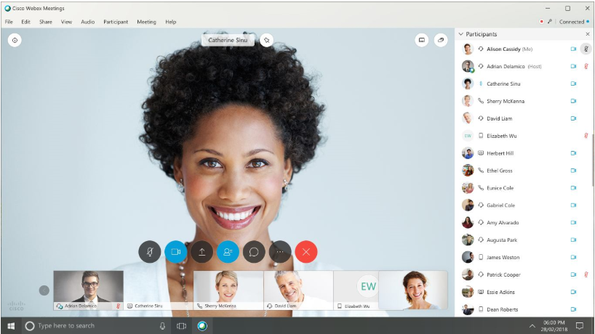
Network Trends Online Collaboration
Collaborate and work with others over the network on joint projects.
Collaboration tools including Cisco WebEx (shown in the figure) gives users a way to instantly connect and interact.
Collaboration is a very high priority for businesses and in education.
Cisco Webex Teams is a multifunctional collaboration tool.
send instant messages
post images
post videos and links

Slide 41
Network Trends Video Communication
Video calls are made to anyone, regardless of where they are located.
Video conferencing is a powerful tool for communicating with others.
Video is becoming a critical requirement for effective collaboration.
Cisco TelePresence powers is one way of working where everyone, everywhere.

Slide 42
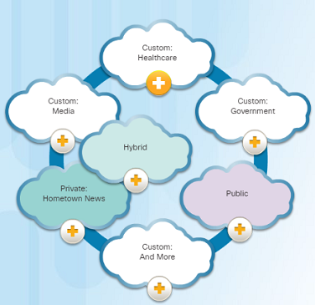
Network Trends Cloud Computing
Cloud computing is a global trend that allows us to store personal files or backup our data on servers over the Internet.
Applications such as word processing and photo editing can also be accessed using the Cloud.
Cloud computing also allows businesses to extend their capabilities on demand and delivered automatically to any device anywhere in the world.
Cloud computing is made possible by data centers. Smaller companies that can’t afford their own data centers, lease server and storage services from larger data center organizations in the Cloud.

Slide 43
Network Trends Cloud Computing (Cont.)
Four types of Clouds:
Public Clouds
Services and applications are made available to the general public through a pay-per-use model or for free.
Private Clouds
Applications and services are intended for a specific organization or entity such as the government.
Hybrid Clouds
Made up of two or more Cloud types – for example, part custom and part public. Each part remains a distinctive object but both are connected using the same architecture.
Custom Clouds

Slide 44
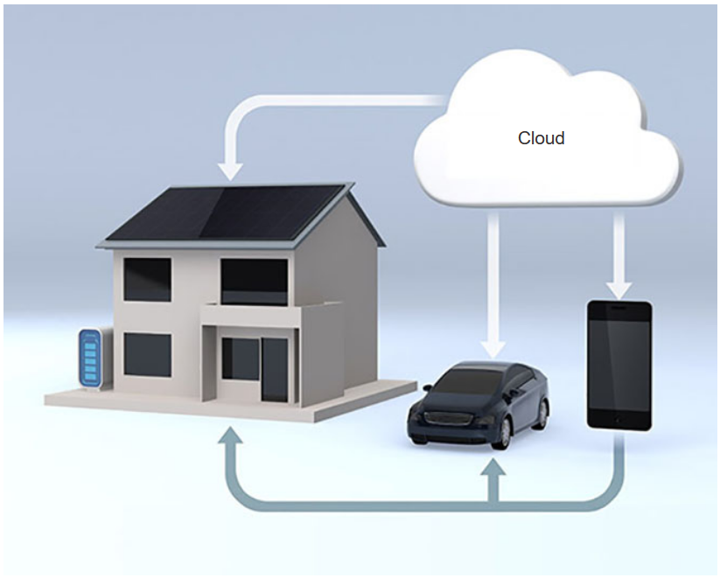
Network Trends Technology Trends in the Home
Smart home technology is a growing trend that allows technology to be integrated into every-day appliances which allows them to interconnect with other devices.
Ovens might know what time to cook a meal for you by communicating with your calendar on what time you are scheduled to be home.
Smart home technology is currently being developed for all rooms within a house.

Slide 45
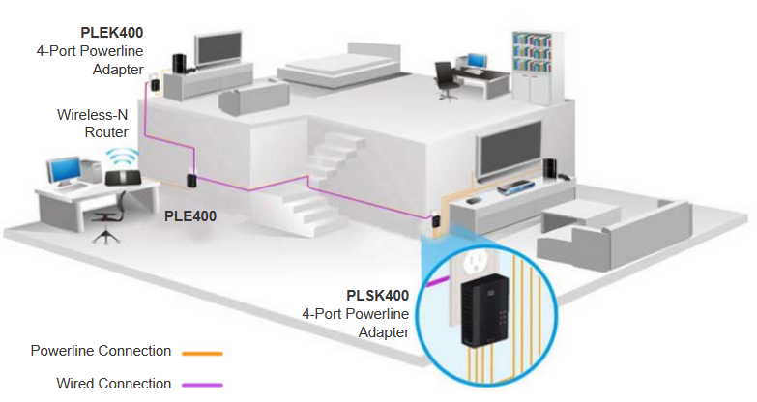
Network Trends Powerline Networking
Powerline networking can allow devices to connect to a LAN where data network cables or wireless communications are not a viable option.
Using a standard powerline adapter, devices can connect to the LAN wherever there is an electrical outlet by sending data on certain frequencies.
Powerline networking is especially useful when wireless access points cannot reach all the devices in the home.

Slide 46
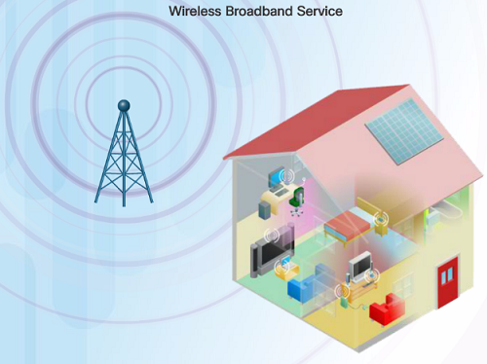
Network Trends Wireless Broadband
In addition to DSL and cable, wireless is another option used to connect homes and small businesses to the internet.
More commonly found in rural environments, a Wireless Internet Service Provider (WISP) is an ISP that connects subscribers to designated access points or hotspots.
Wireless broadband is another solution for the home and small businesses.
Uses the same cellular technology used by a smart phone.
An antenna is installed outside the house providing wireless or wired connectivity for devices in the home.

Slide 47
1.8 Network Security

Slide 48
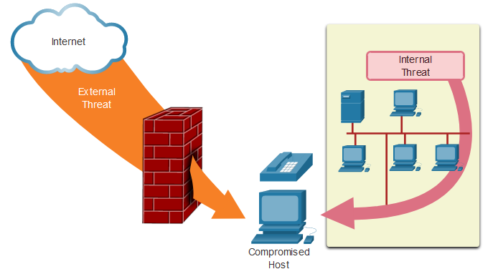
Network Security Security Threats
Network security is an integral part of networking regardless of the size of the network.
The network security that is implemented must take into account the environment while securing the data, but still allowing for quality of service that is expected of the network.
Securing a network involves many protocols, technologies, devices, tools, and techniques in order to secure data and mitigate threats.
Threat vectors might be external or internal.

Slide 49
Network Security Security Threats (Cont.)
External Threats:
Viruses, worms, and Trojan horses
Spyware and adware
Zero-day attacks
Threat Actor attacks
Denial of service attacks (DoS)
Data interception and theft
Identity theft
Internal Threats:
lost or stolen devices
accidental misuse by employees
malicious employees

Slide 50
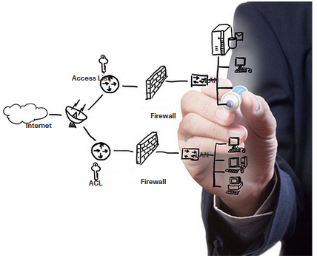
Network Security Security Solutions
Security must be implemented in multiple layers using more than one security solution.
Network security components for home or small office network:
Antivirus and antispyware software should be installed on end devices.
Firewall filtering used to block unauthorized access to the network.

Slide 51
Network Security Security Solutions (Cont.)
Larger networks have additional security requirements:
Dedicated firewall system
Access control lists (ACL)
Intrusion prevention systems (IPS)
Virtual private networks (VPN)
The study of network security starts with a clear understanding of the underlying switching and routing infrastructure.

